Slide 1
Generic And Collection

Slide 2
Pre-Generic Code
class GeneralClass
{
Object ob;
GeneralClass(Object ob){
this.ob = ob;
}
Object getOb(){
return ob;
}
}
GeneralClass g1 = new GeneralClass(new Integer(100));
Integer i1 = (Integer)g1.getOb();
GeneralClass g2 = new GeneralClass(“Hello World”);
String s1 = (String)g2.getOb();

Slide 3
Disadvantages of Pre-Generic Code
1] No Type Safety
Integer i1 = (Integer)g1.getOb();
// required explicit type casting
2] Without RTTI Program Crashes
g1 = g2; // now g1 contains String
Integer i2 = (Integer)g1.getOb();
// throws ClassCastException

Slide 4
Why Generics
Many algorithms are logically same irrespective of type of data to which they are applied.
Useful to define algorithm once, independent of any type of data.
Collections like Stack, Queue, etc
To create Generic classes, interfaces and methods which work in type-safe manner with various types of data elements.

Slide 5
What are Generics?
Parameterized Types
Uses type-parameter or placeholder
Single Class, Interface or Method works with different types of data automatically.
Used to create
Generic Class
Generic Interface
Generic Method

Slide 6
Creating Generic Class
Generic Syntax:
class ClassName<Type-Parameter-List>{
}
class Gen<T> {
T ob;
Gen(T ob){
this.ob = ob;
}
T getOb(){
return ob;
}
}

Slide 7
Instantiating Generic class
Syntax:
ClassName<Type-Argument-List> ref =
new ClassName<Type-Argument-List>();
where Type-Argument-List for reference must match that of instance
eg. Gen<Integer> iob =
new Gen<Integer>();

Slide 8
Characteristics
Generics works only with objects
Gen<Integer> iob =
new Gen<Integer>(new Integer(100));
Gen<String> sob =
new Gen<String>(“Hello World”);
Gen<int> g = new Gen<int>(100); // compiler error
Generic type differ based on their type arguments
iob = sob; // compiler error

Slide 9
Advantages
Type Safety
No need of explicit type casting
All casts are automatic and implicit
Integer i1 = iob.getOb();
String s1 = sob.getOb();

Slide 10
multiple type-parameters
class GenTwo<T,V,M>
{
T ob1;
V ob2;
M ob3;
}
GenTwo<Integer,String> isob =
new GenTwo<Integer,String>();

Slide 11
Bounded Type
works on specific hierarchy of classes or interfaces
class ClassName<T extends ClassType>
class ClassName<T extends InterfaceType>
class AverageCalci<T extends Number>
{
}
AverageCalci<Double> dob =
new AverageCalci<Double>();
AverageCalci<String> sob =
new AverageCalci<String>(); // compiler error
As String is not within the bound of Number

Slide 12
Why Collections?
Array size is fixed. Size cannot be increased dynamically.
In actual development scenario, same type of objects need to be processed.

Slide 13
Why Collections?
Data is obtained from data source like files or database.
Values obtained can be single or multiple objects.
Two methods need to be defined . Moreover array size is fixed
public Customer getData1()
{
// . . . Code
return obj;
}
public Customer[] getData2()
{
// . . . Code
return ArrayObj;
}

Slide 14
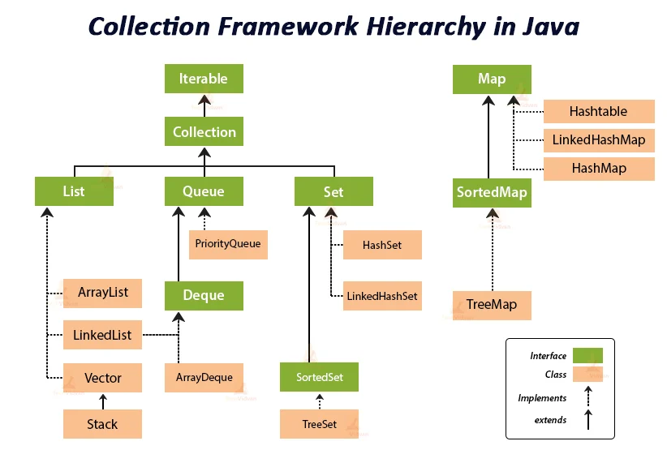

Slide 15
Collection Interfaces
Allow collections to support a different behavior
Interface | Description
List | Represents a collection of objects that is accessed by an index. An Ordered collection .
Set | Represents a collection that contains no duplicate elements.An order is not fixed.
Map | Represents a collection of key-value pairs .
Queue | Represents a collection designed for holding elements prior to processing.
Iterator | Supports a simple iteration over collection.
Comparator | comparison function, which imposes a total ordering on some collection of objects.

Slide 16
List interface
Ordered Collection.
May contain duplicates.
Implemented by classes:
ArrayList
Resizable-array implementation of the List interface.
LinkedList
Doubly-linked list implementation of the List
Vector
The Vector class implements a growable array of objects.

Slide 17
Set Interface
Collection of unique elements.
No duplicate elements allowed.
Collection not in any particular order (random).
Implemented by the HashSet.

Slide 18
SortedSet Interface
A sorted set is a set.
Used for the sorting purpose.
The elements are ordered using their natural ordering.
All elements inserted into a sorted set must implement the Comparable interface.
Implemented by the TreeSet.

Slide 19
Map Interface
Map associates key with values.
Map cannot contain duplicate keys.
Implemented by the HashMap.

Slide 20
Iterator Interface
Allow users to visit the elements in the container one by one.
This interface contain 3 methods:
Object next()
boolean hasNext()
void remove()
Iterator i= a.iterator();
while( i.hasNext())
{
System.out.println( i.next());
}
/* consider ArrayList contain 5 elements now iterate these elements
ArrayList a=new ArrayList();
a.add(4);a.add(5);a.add(1),a.add(7);a.add(“hello”);
*/

Slide 21
Comparator Interface
A comparison function, which imposes a total ordering on a collection of objects.
Comparable used to
Provide an ordering for collections of objects that do not have a natural ordering.
Control the order of certain data structures (such as sorted sets or sorted maps).
Comparators can be passed to a sort method
Collection.sort()or Arrays.sort() to maintain the control over the sort order.
Method is int compare(Object o1,Object o2)

Slide 22
Comparator-Example
class EmpCompartor implements Comparator<Employee>{
public int compare(Employee e1, Employee e2){
int emp1Age = e1.getAge();
int emp2Age = e2.getAge();
if(emp1Age > emp2Age)
return 1;
else if(emp1Age < emp2Age)
return -1;
else
return 0;
}
}
employee[0] = new Employee();
employee[0].setAge(40);
employee[1] = new Employee();
employee[1].setAge(20);
Arrays.sort(employee, new EmpComparator());
System.out.println("\n\nOrder of employee after sorting by employee age is");
for(int i=0; i < employee. length; i++){
System.out.println( “Age :: " + employee[i].getAge());
}
class Employee
{
int eid
String ename;
int age;
//appropriate constructor and properties present
}

Slide 23
Java 8 Stream
Java provides a new additional package in Java 8 called java.util.stream.
This package consists of classes, interfaces and enum to allows functional-style operations on the elements.
You can use stream by importing java.util.stream package.
You can use stream to filter, collect, print, and convert from one data structure to other etc

Slide 24
Features
Stream does not store elements. It simply conveys elements from a source such as a data structure, an array, or an I/O channel, through a pipeline of computational operations.
Stream is functional in nature. Operations performed on a stream does not modify it's source. For example, filtering a Stream obtained from a collection produces a new Stream without the filtered elements, rather than removing elements from the source collection.
Stream is lazy and evaluates code only when required.
The elements of a stream are only visited once during the life of a stream. Like an Iterator, a new stream must be generated to revisit the same elements of the source.

Slide 25
Different Operations On Streams
There are two types of Operations in Streams:
Intermediate Operations:
Intermediate Operations are the types of operations in which multiple methods are chained in a row.
Terminate Operations:
Terminal Operations are the type of Operations that return the result. These Operations are not processed further just return a final result value.

Slide 26
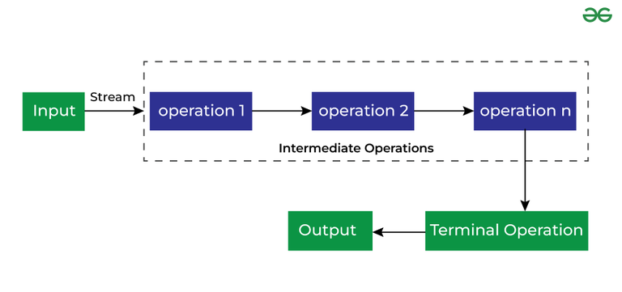
Intermediate Operations

Slide 27
Important Intermediate Operations
1. map()
The map method is used to return a stream consisting of the results of applying the given function to the elements of this stream.
2. filter()
The filter method is used to select elements as per the Predicate passed as an argument.
3. sorted()
The sorted method is used to sort the stream.

Slide 28
Important Terminal Operations
1. collect()
The collect method is used to return the result of the intermediate operations performed on the stream.
2. forEach()
The forEach method is used to iterate through every element of the stream.
3. reduce()
The reduce method is used to reduce the elements of a stream to a single value. The reduce method takes a BinaryOperator as a parameter.

Slide 29
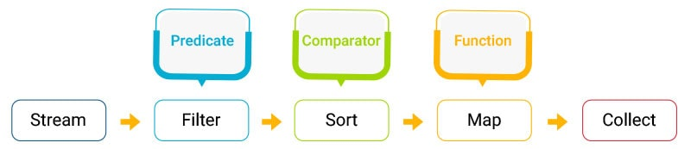
Stream API
Stream API is a newly added feature to the Collections API in Java Eight.
A stream represents a sequence of elements and supports different operations (Filter, Sort, Map, and Collect) from a collection.

Slide 30
//Purpose: Filters the elements of a stream based on a given predicate.
List<String> fruits = Arrays.asList("apple", "banana", "orange", "kiwi", "mango");
List<String> result = fruits.stream()
.filter(fruit -> fruit.startsWith("a"))
.collect(Collectors.toList());
// Result: [apple]

